Slide 1
C - Operators

Slide 2
Operators
An operator is a symbol that tells the compiler to perform specific mathematical or logical functions. C language is rich in built-in operators and provides the following types of operators
Arithmetic Operators
Relational Operators
Logical Operators
Bitwise Operators
Assignment Operators
Misc Operators

Slide 3
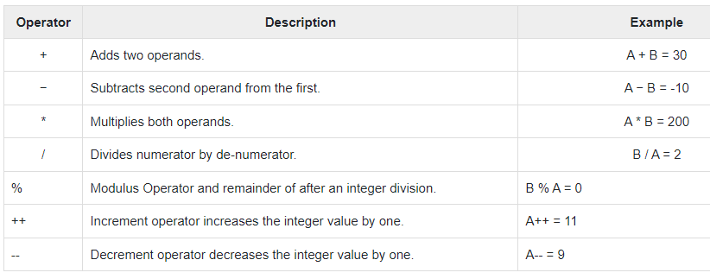
Arithmetic Operators
The following table shows all the arithmetic operators supported by the C language. Assume variable A holds 10 and variable B holds 20 then

Slide 4
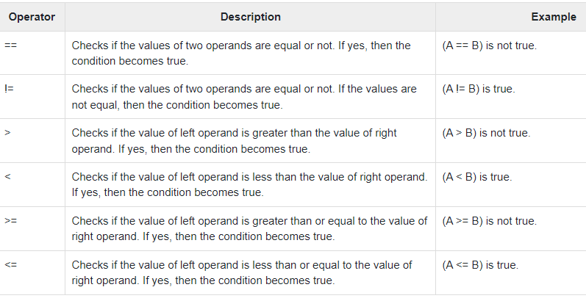
Relational Operators
The following table shows all the relational operators supported by C. Assume variable A holds 10 and variable B holds 20 then

Slide 5
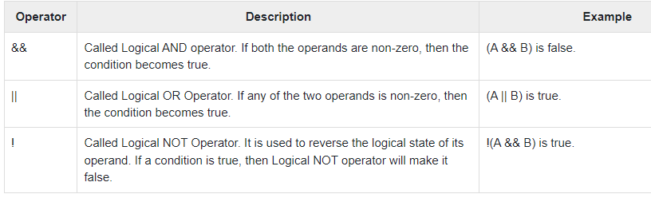
Logical Operators
Following table shows all the logical operators supported by C language. Assume variable A holds 1 and variable B holds 0, then

Slide 6
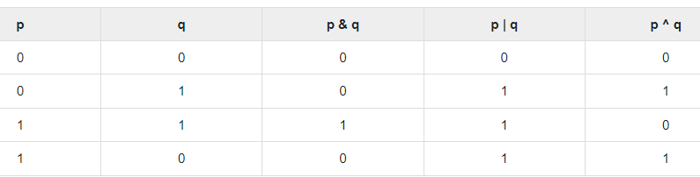
Bitwise Operators
Bitwise operator works on bits and perform bit-by-bit operatio
n. The truth tables for &, |, and ^ is as follows −

Slide 7
Assume A = 60 and B = 13 in binary format, they will be as follows −
A = 0011 1100
B = 0000 1101
-----------------
A&B = 0000 1100
A|B = 0011 1101
A^B = 0011 0001
~A = 1100 0011

Slide 8
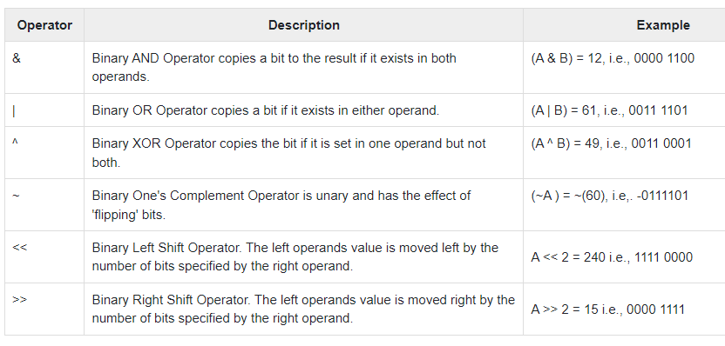
The following table lists the bitwise operators supported by C. Assume a variable 'A' holds 60 and variable 'B' holds 13, then −

Slide 9
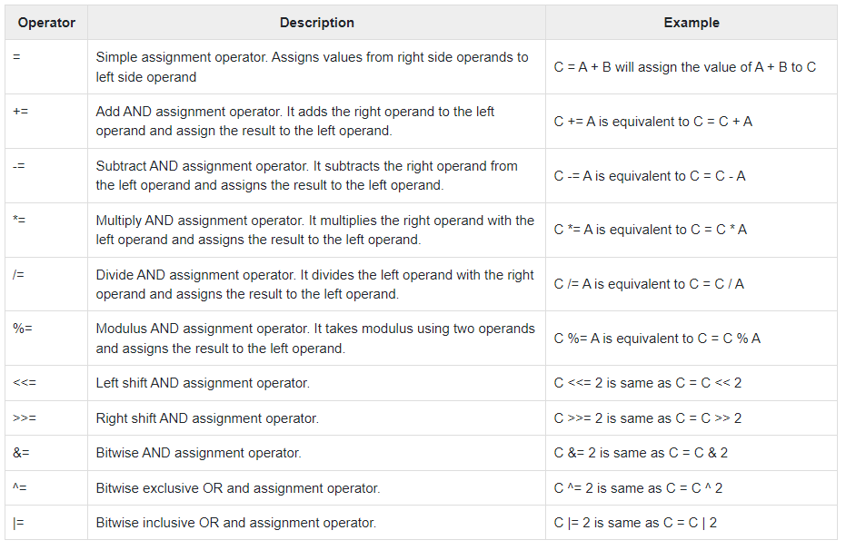
Assignment Operators
The following table lists the assignment operators supported by the C language

Slide 10
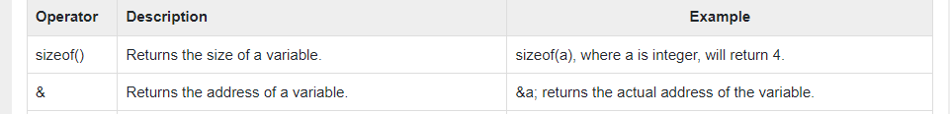
Misc Operators
Besides the operators discussed above, there are a few other important operators

